Slide 1
Exercise 8
Plant Structure

Slide 2
In this lab, you studied the structure of flowering plants. This page contains photos of the wet-mounts you made, as well as the prepared slides of the different regions of flowering plants. For each image, identify the tissues and cell types as described in your lab manual, and know their functions.

Slide 3
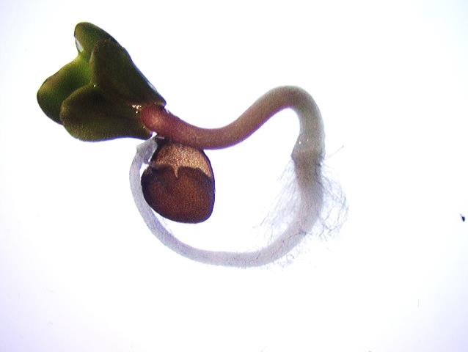
Root Hairs

Slide 4
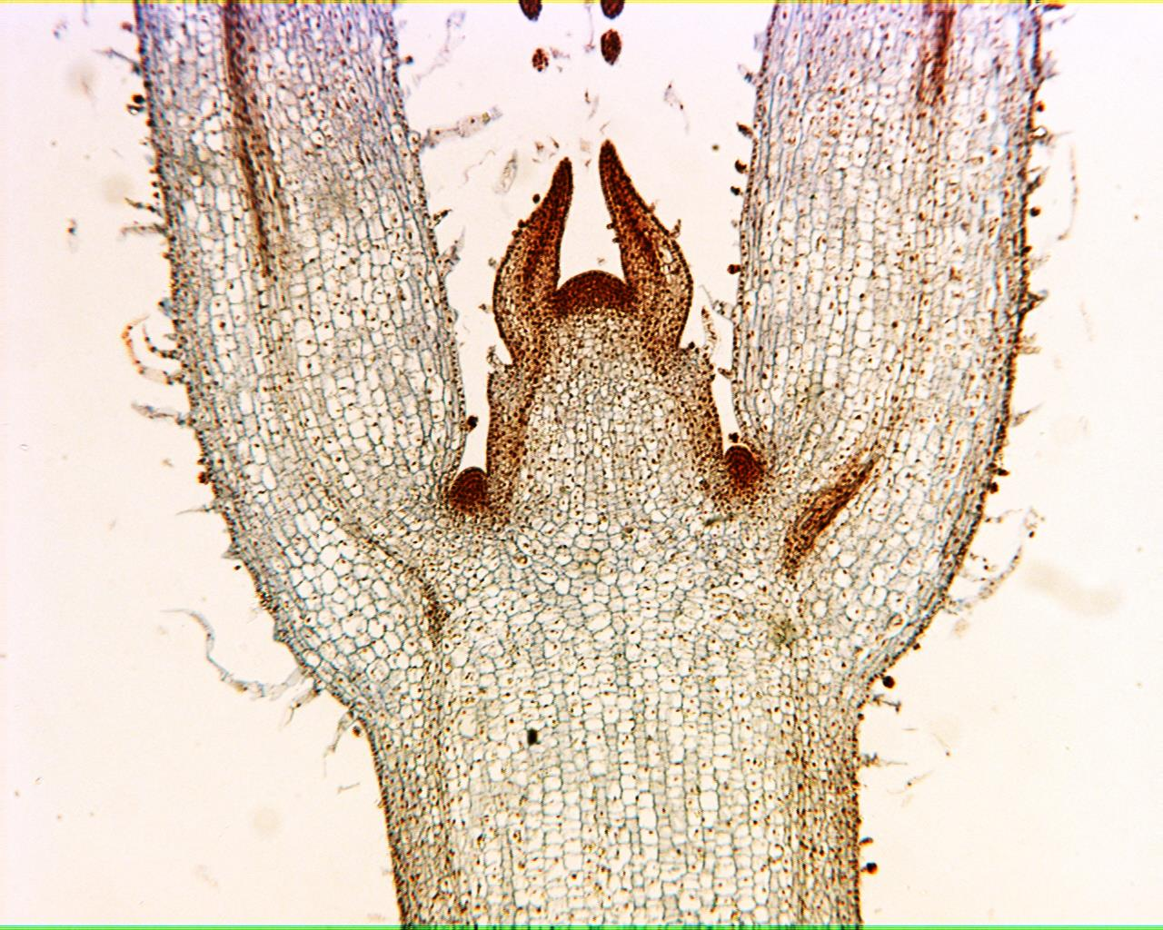
Coleus Stem Tip 40X

Slide 5
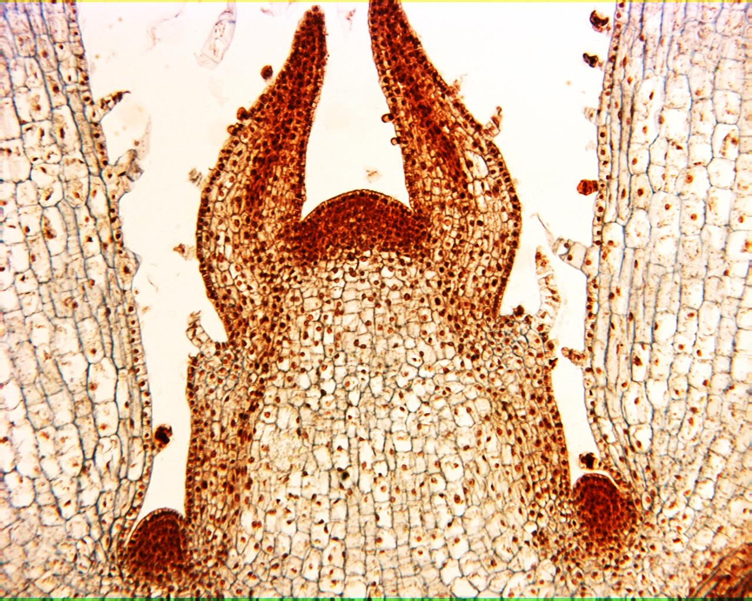
Coleus Stem Tip 100X

Slide 6
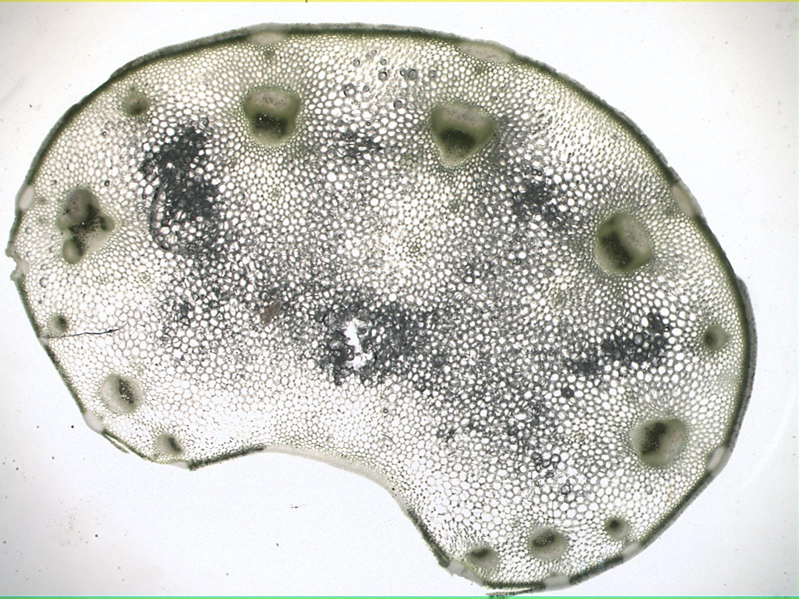
Celery 15X

Slide 7
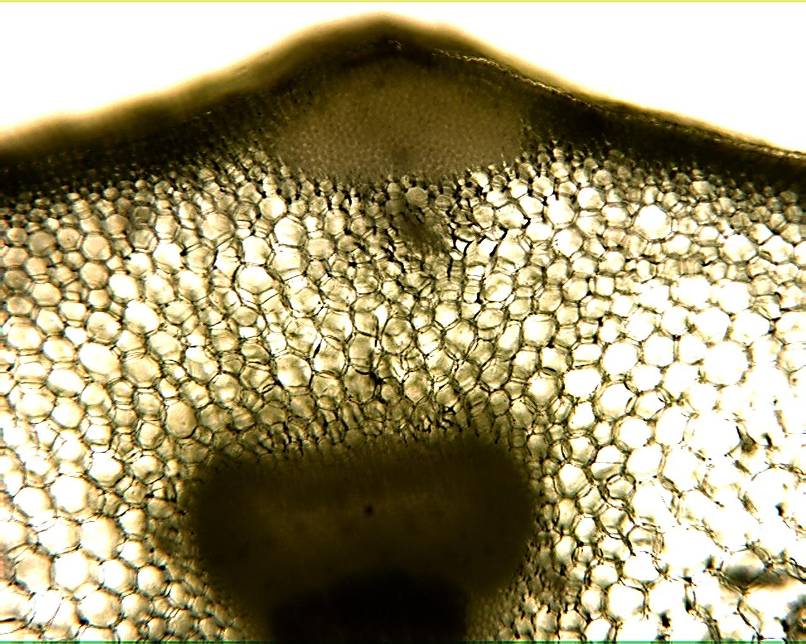
Celery 40X

Slide 8
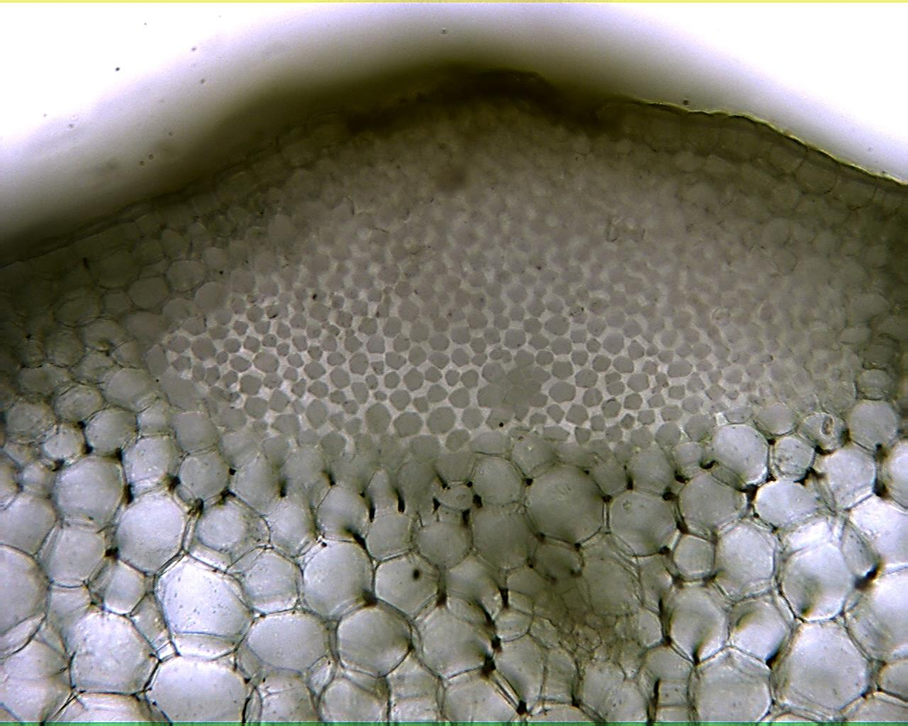
Celery 100X

Slide 9
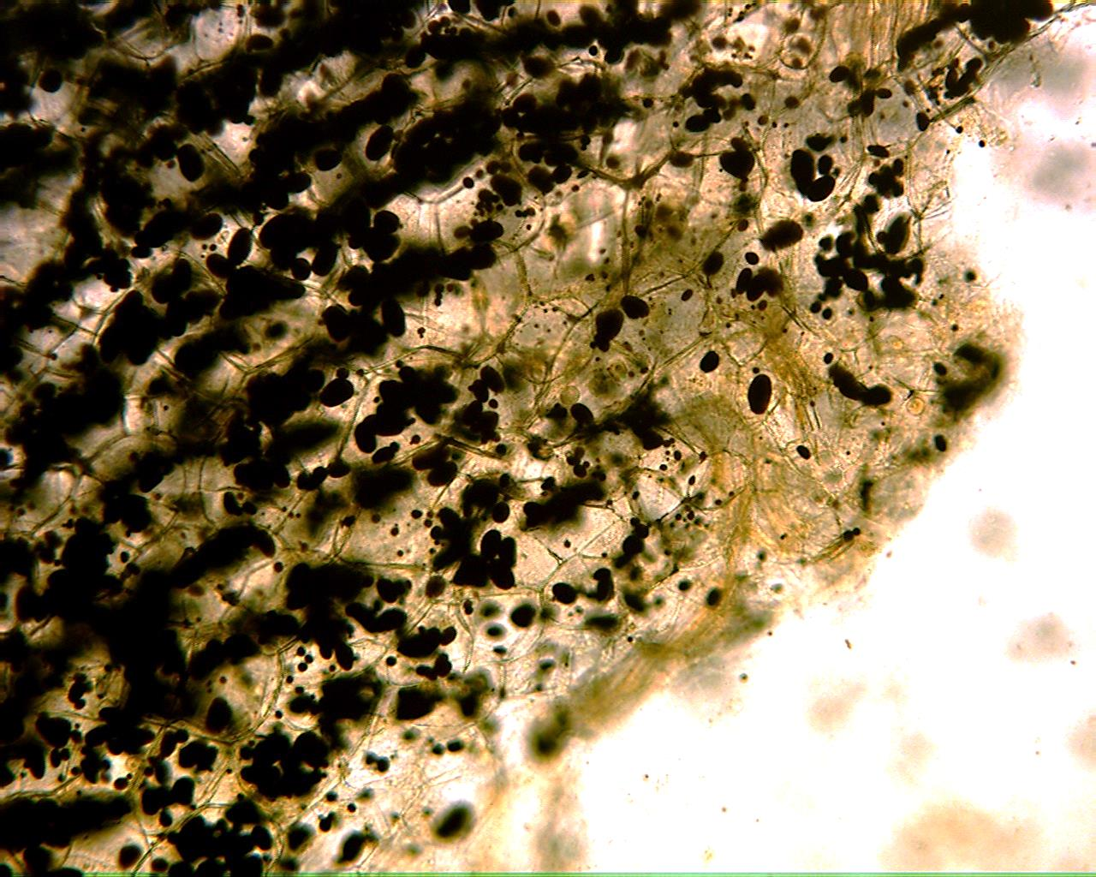
Potato 100X

Slide 10
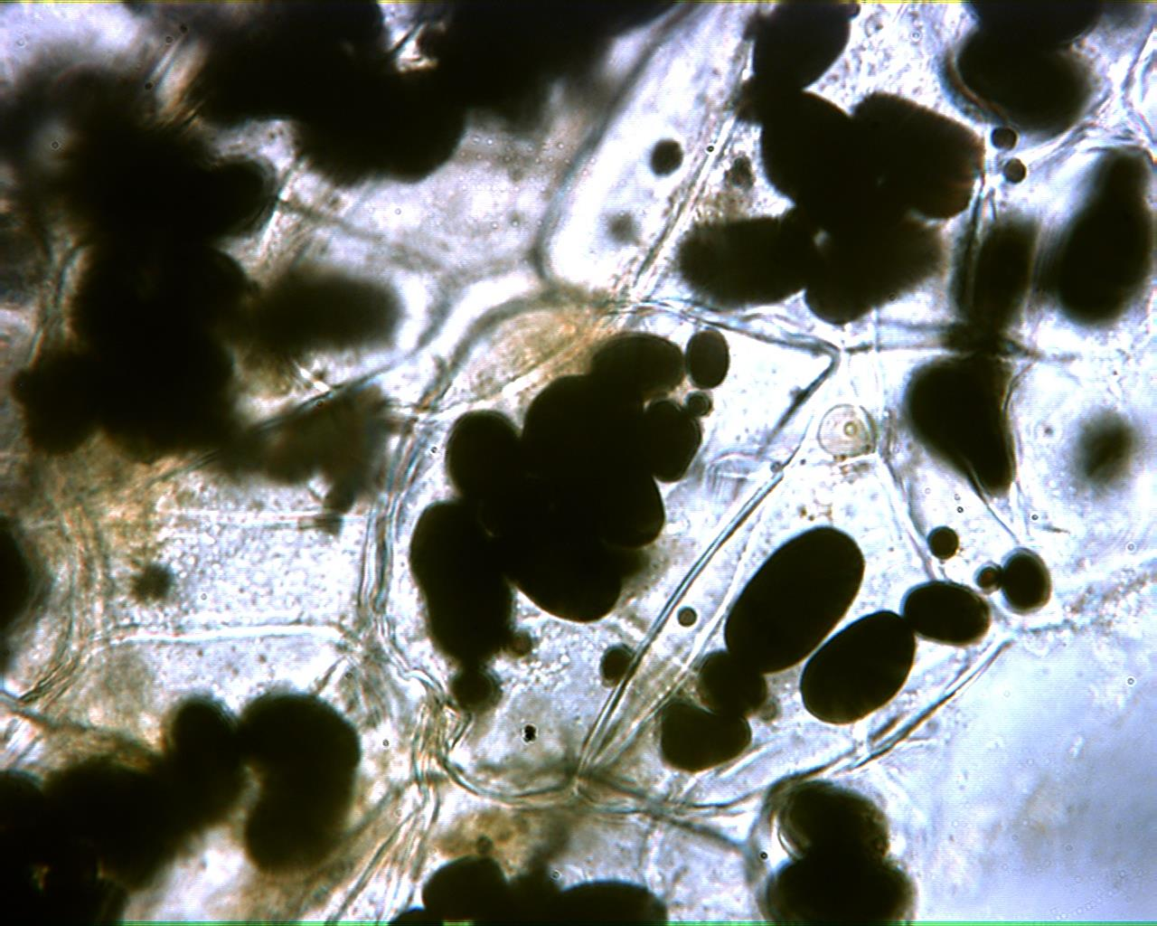
Potato 400X

Slide 11
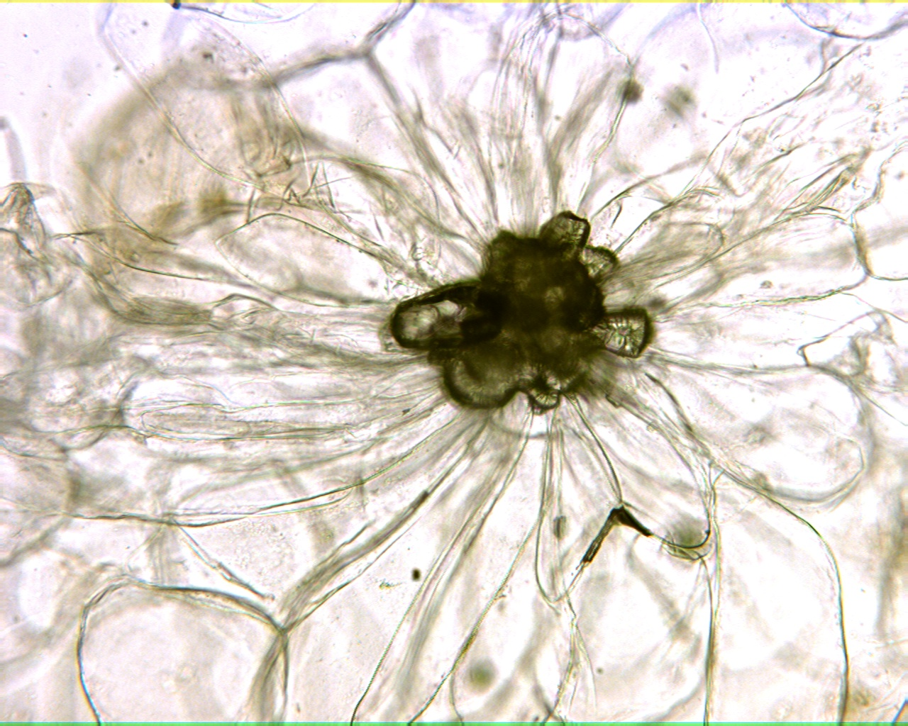
Pear 100X

Slide 12
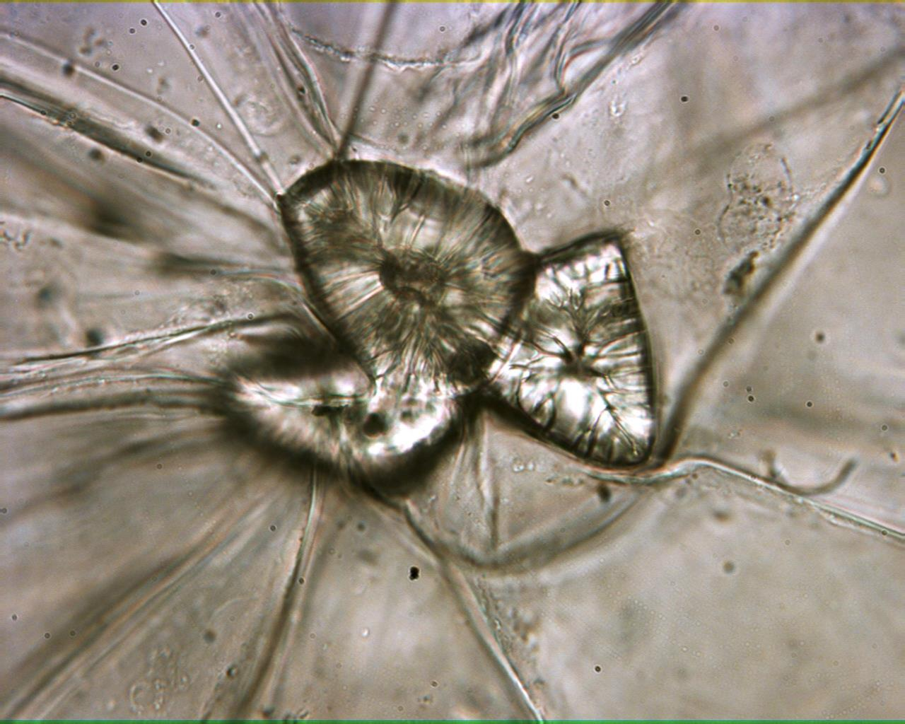
Pear 400X

Slide 13
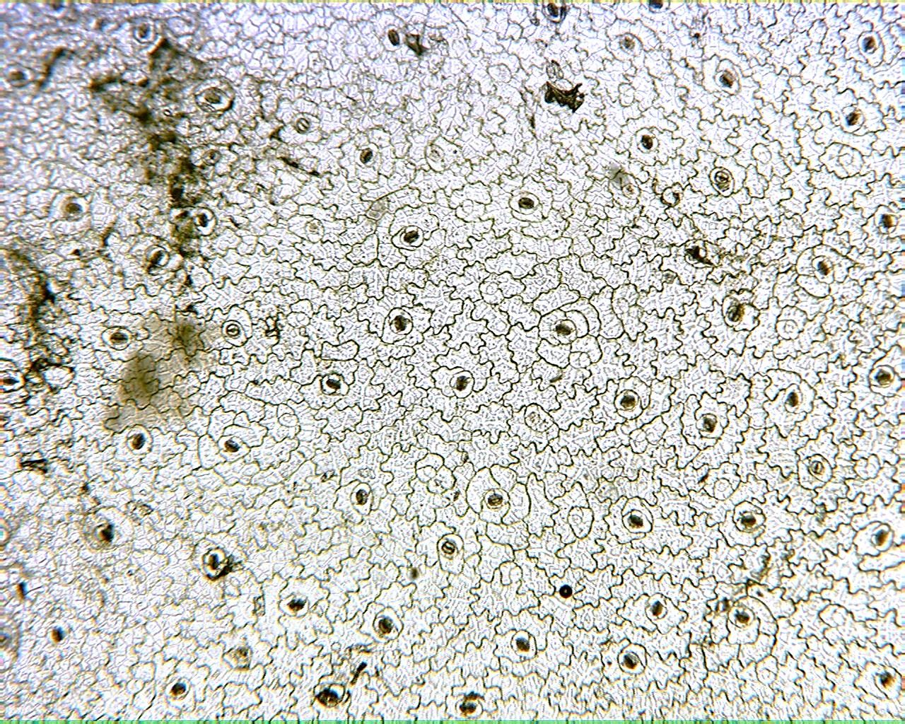
Leaf Epidermis 40X

Slide 14
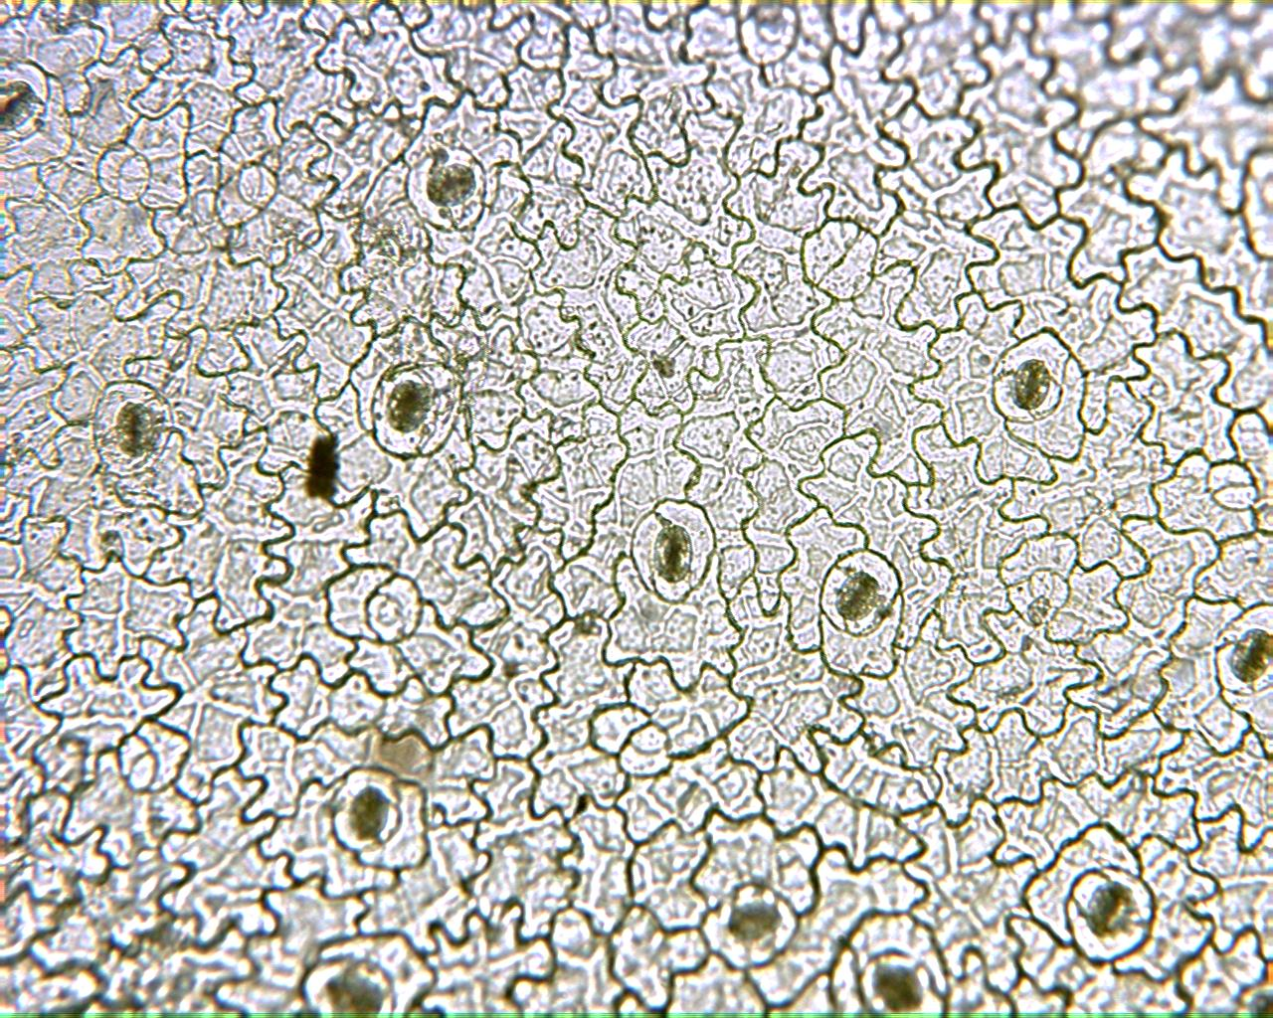
Leaf Epidermis 100X

Slide 15
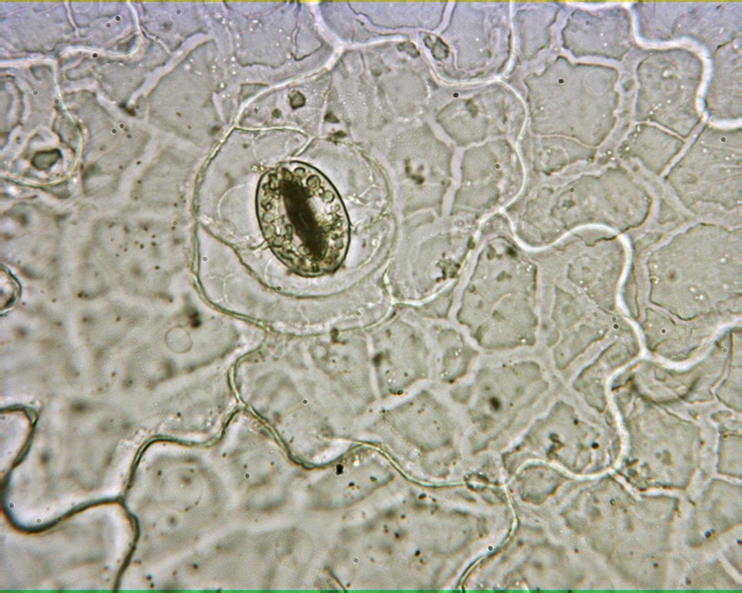
Leaf Epidermis 400X

Slide 16
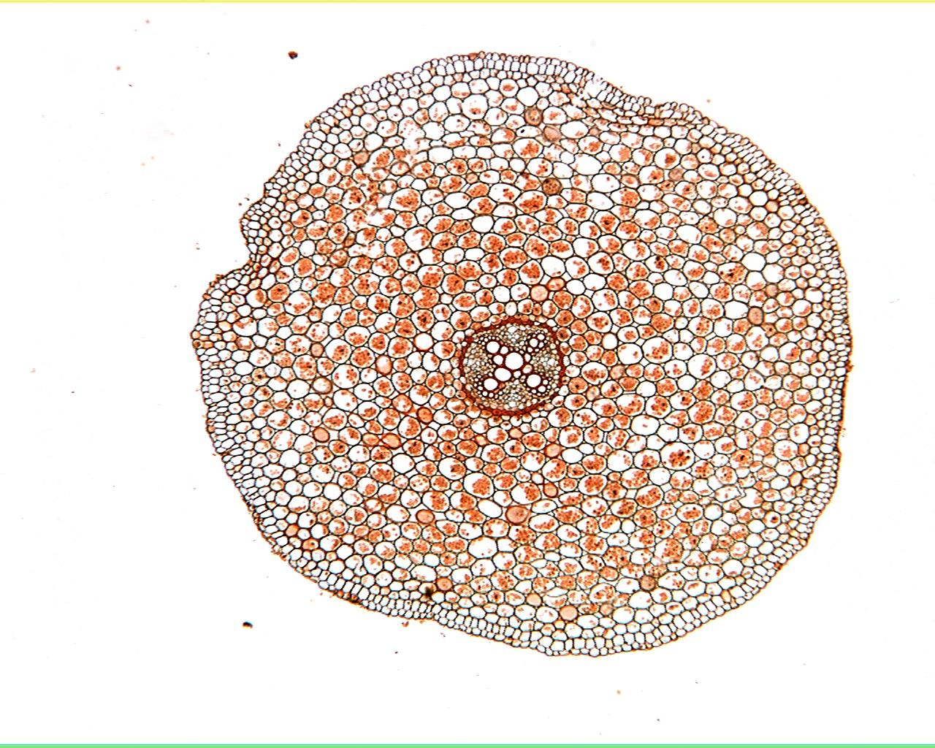
Ranunculus Root 40X

Slide 17
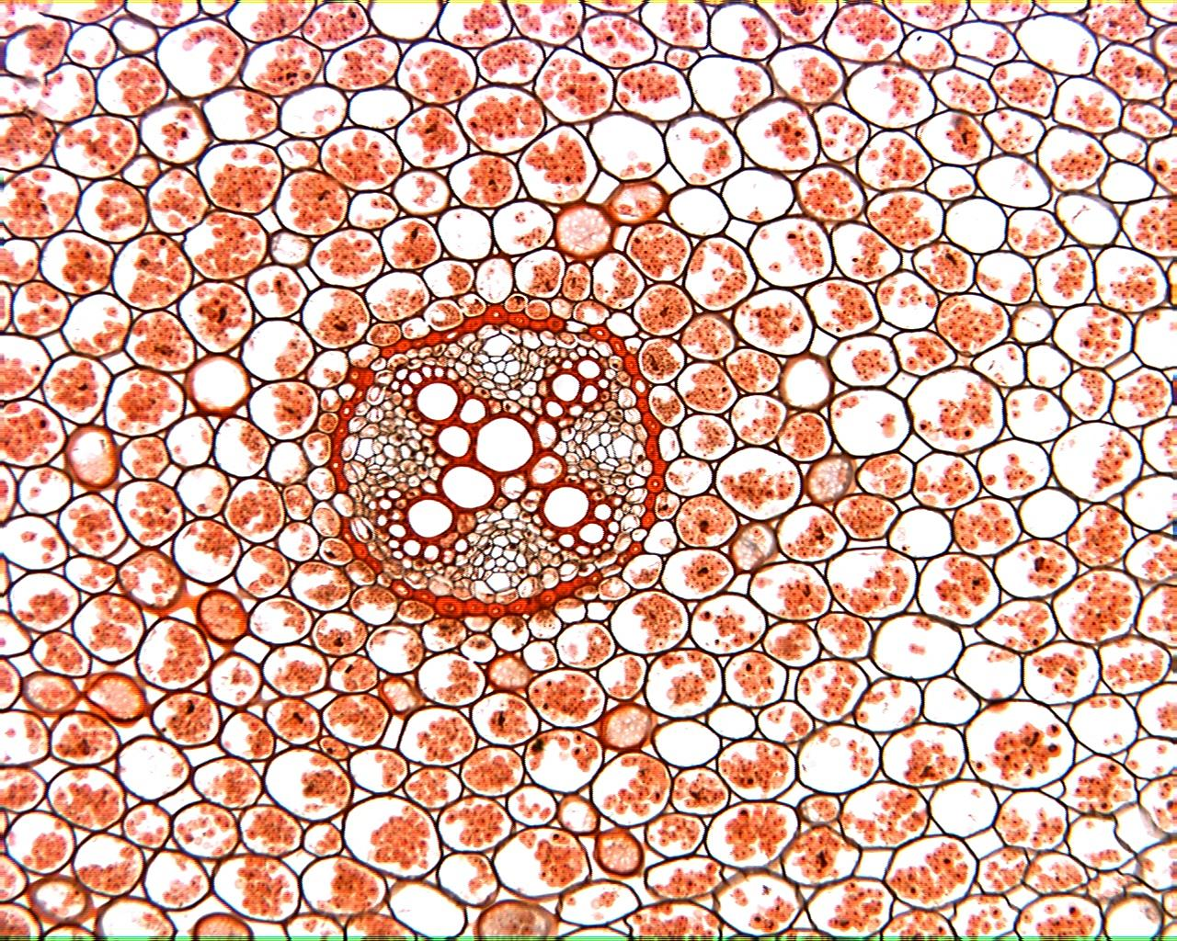
Ranunculus Root 100X

Slide 18
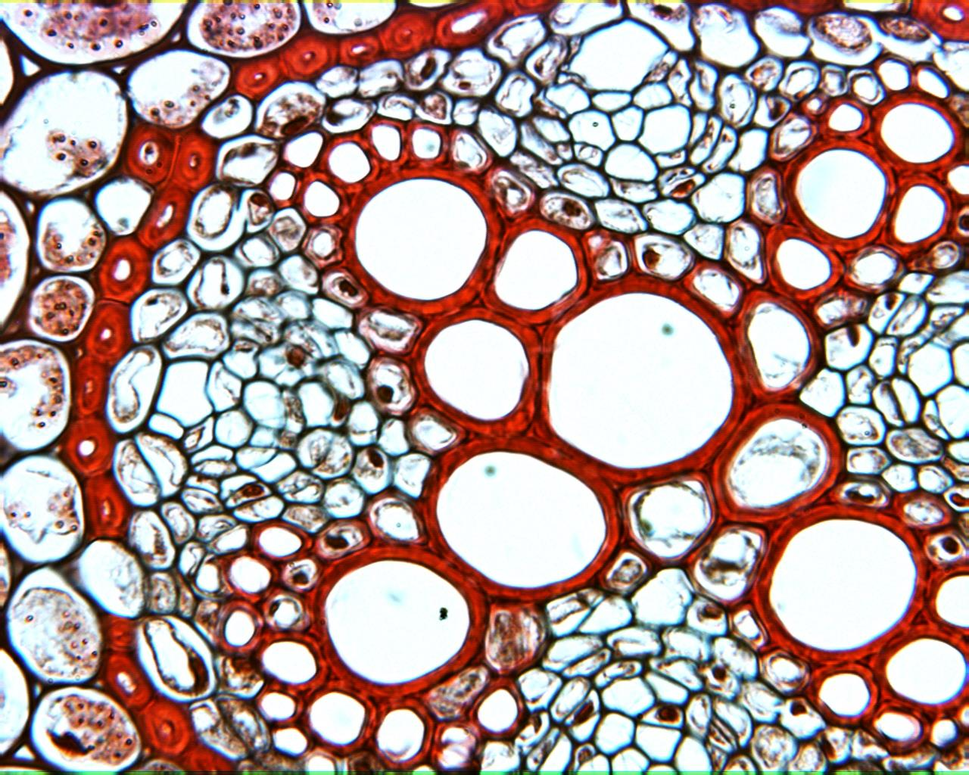
Ranunculus Root 400X

Slide 19
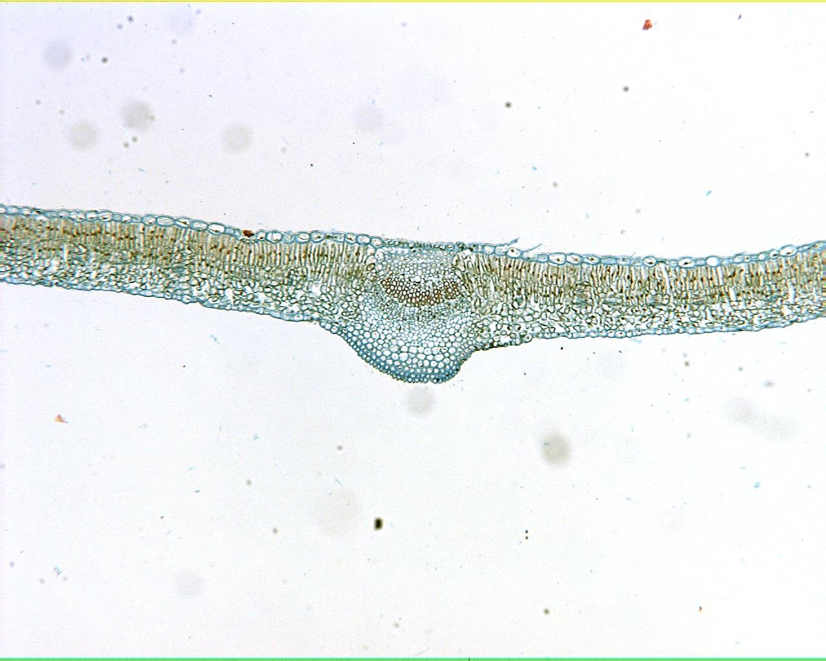
Syringa Leaf 40X

Slide 20
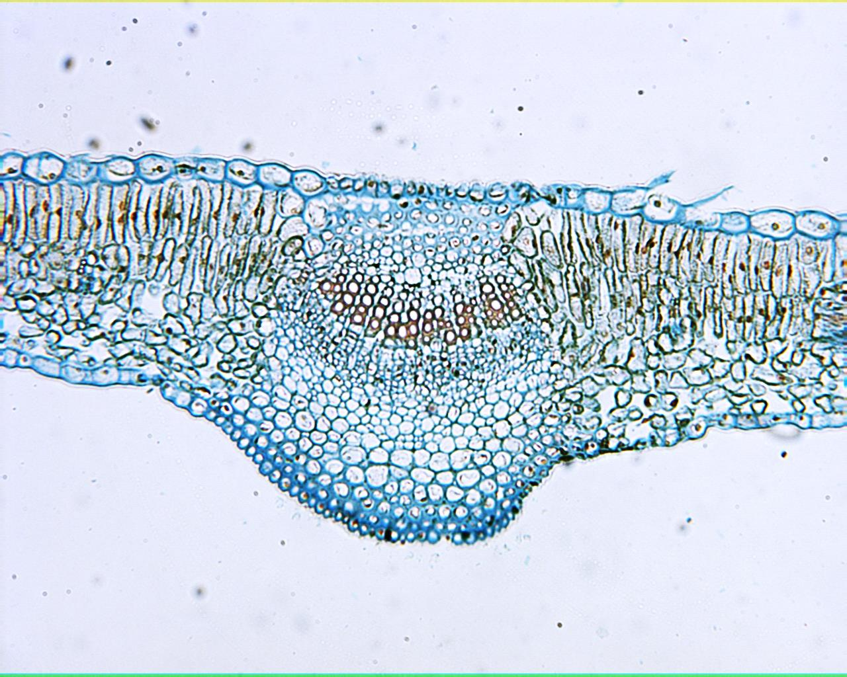
Syringa Leaf Midrib Vein 100X

Slide 21
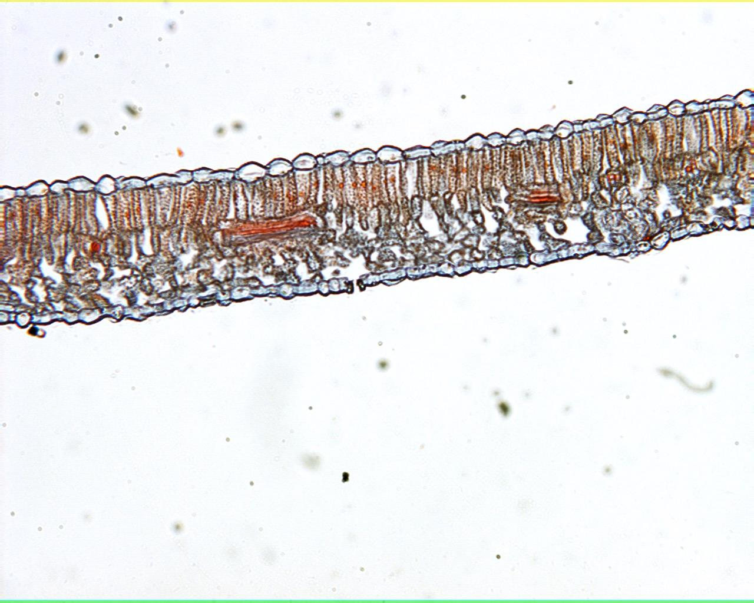
Syringa Leaf 100X

Slide 22
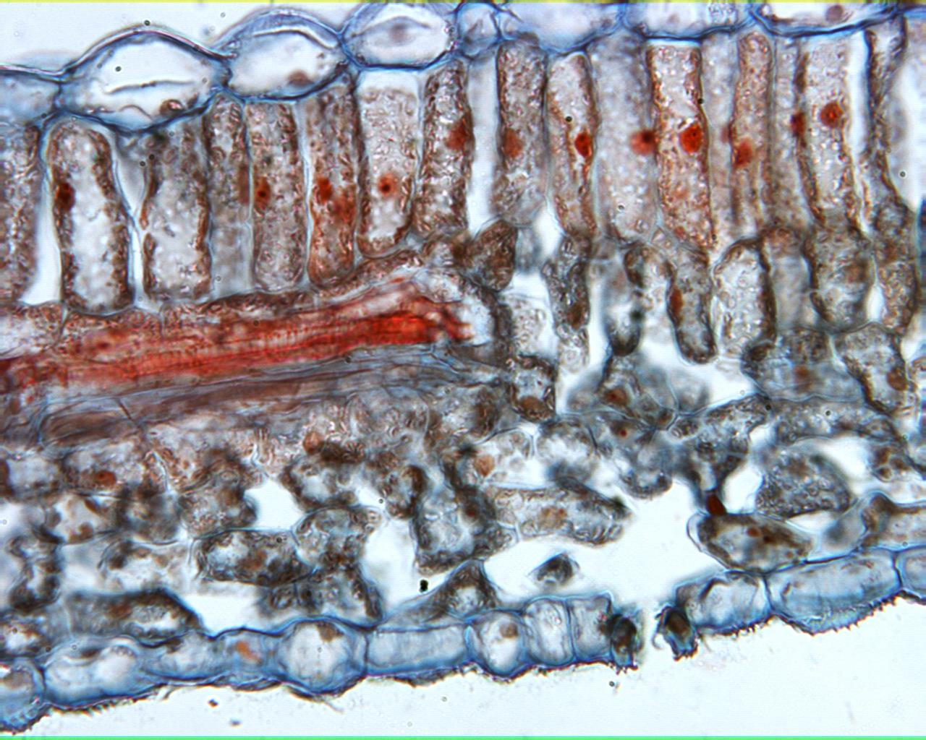
Syringa Leaf 400X

Slide 23
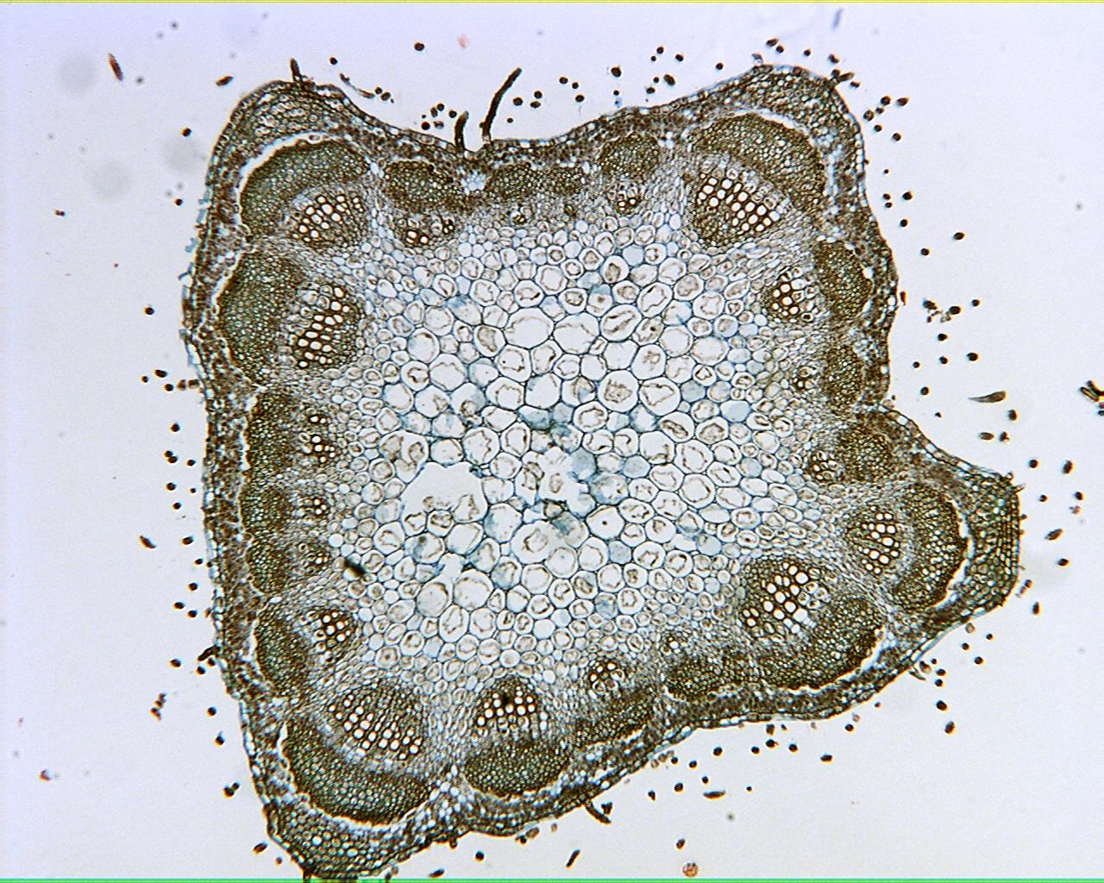
Medicago Young Stem 40X

Slide 24
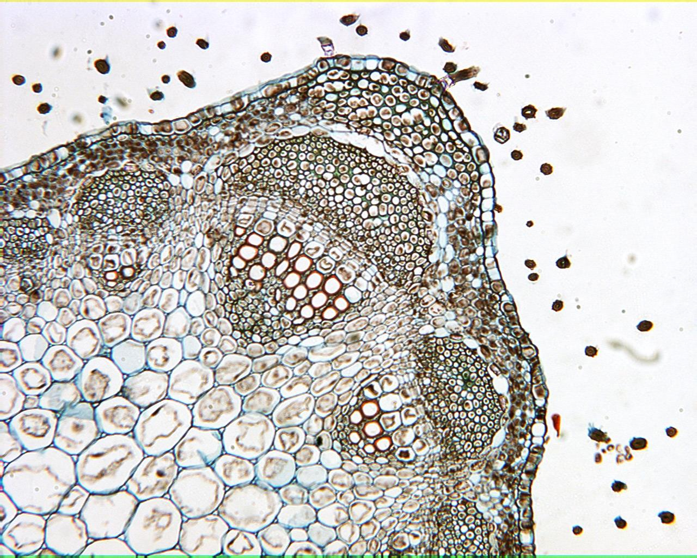
Medicago Young Stem 100X

Slide 25
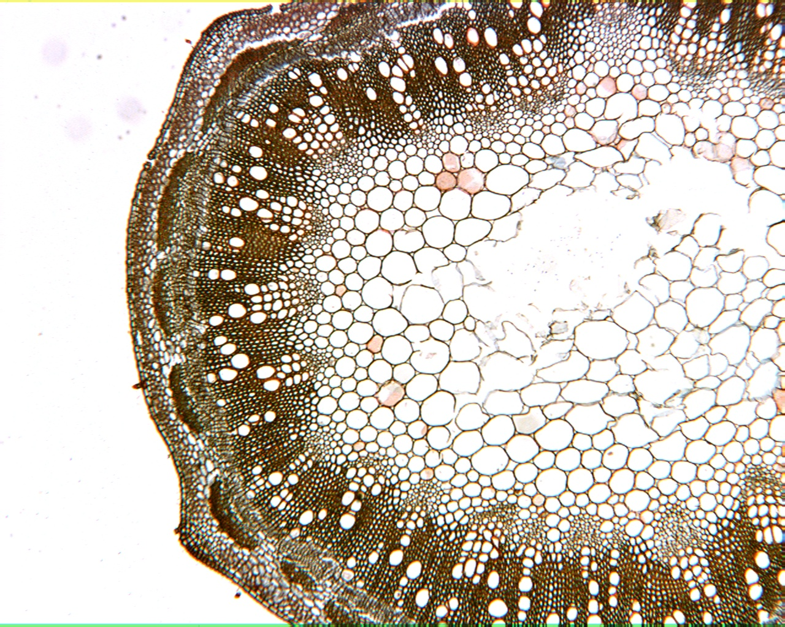
Medicago Older Stem 40X

Slide 26
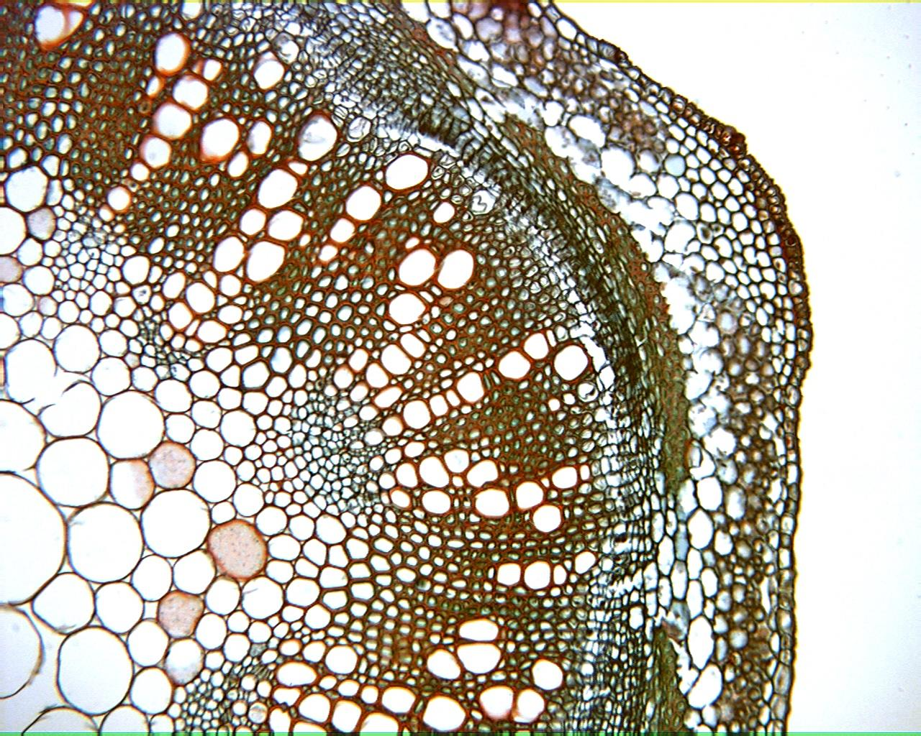
Medicago Older Stem 100X

Slide 27
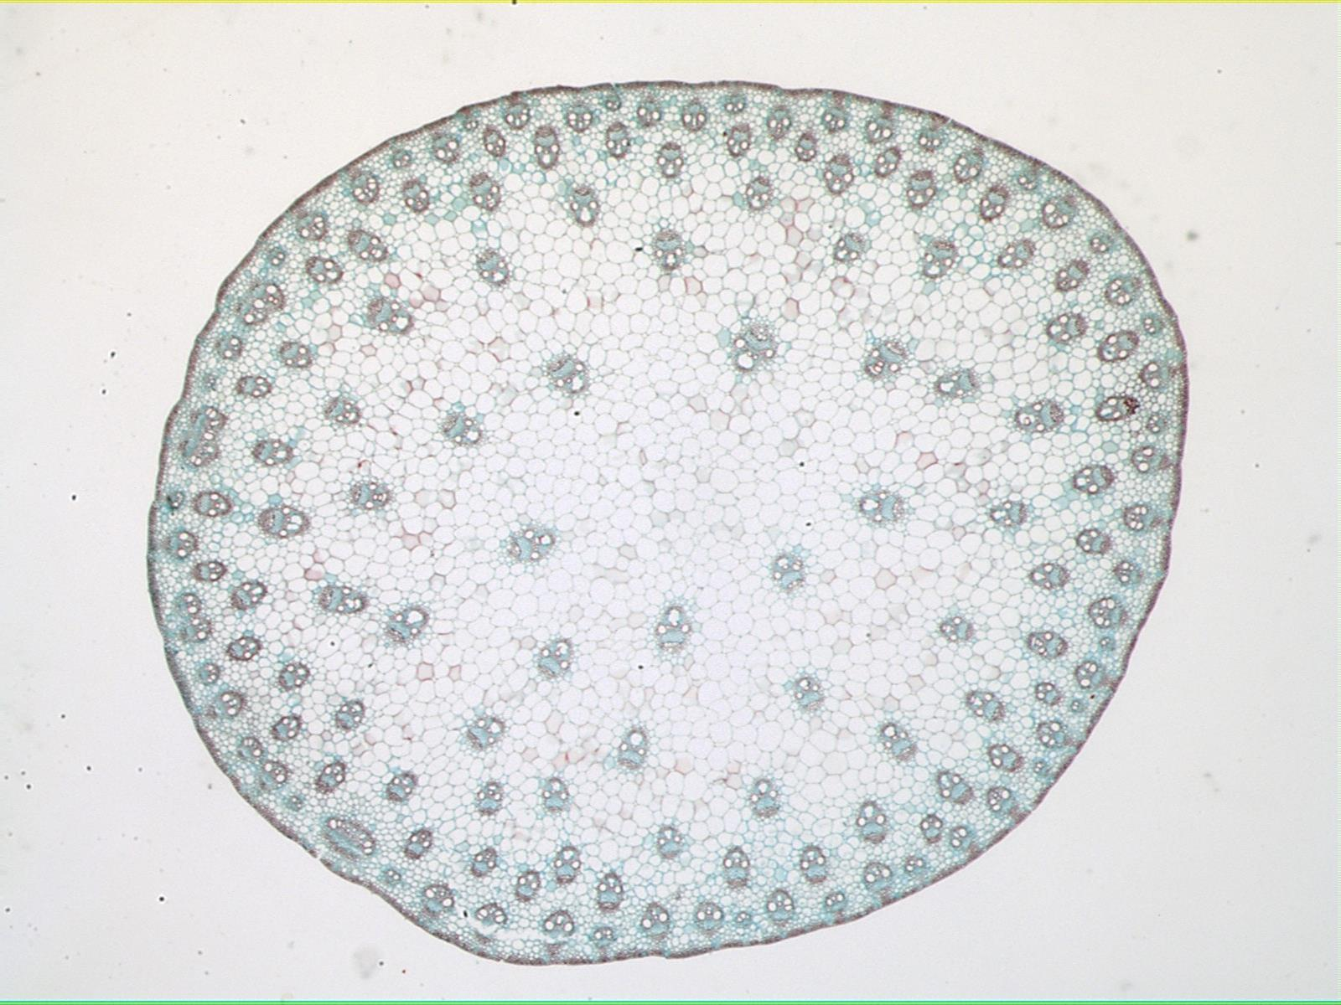
Zea Stem 30X

Slide 28
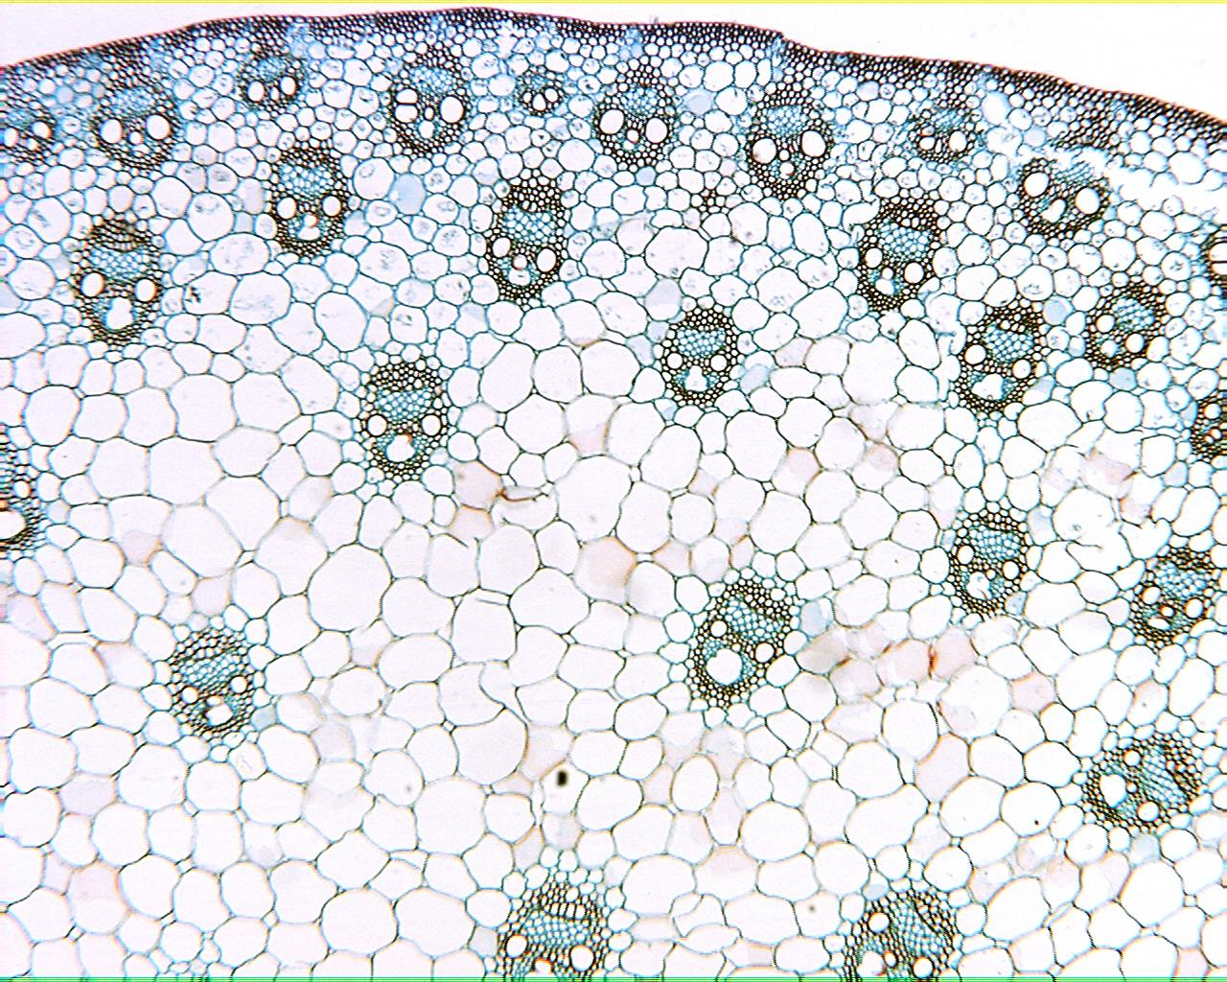
Zea Stem 40X

Slide 29
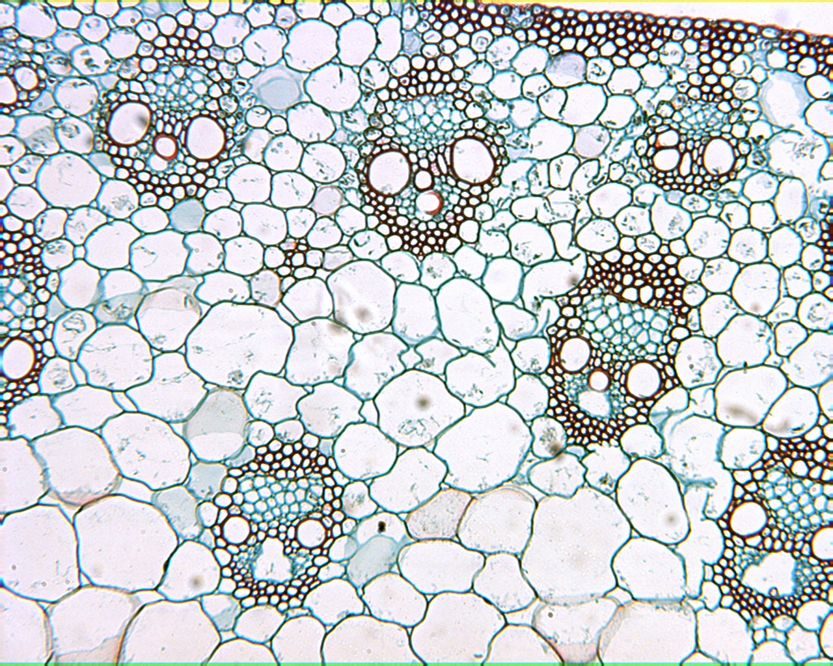
Zea Stem 100X

Slide 30
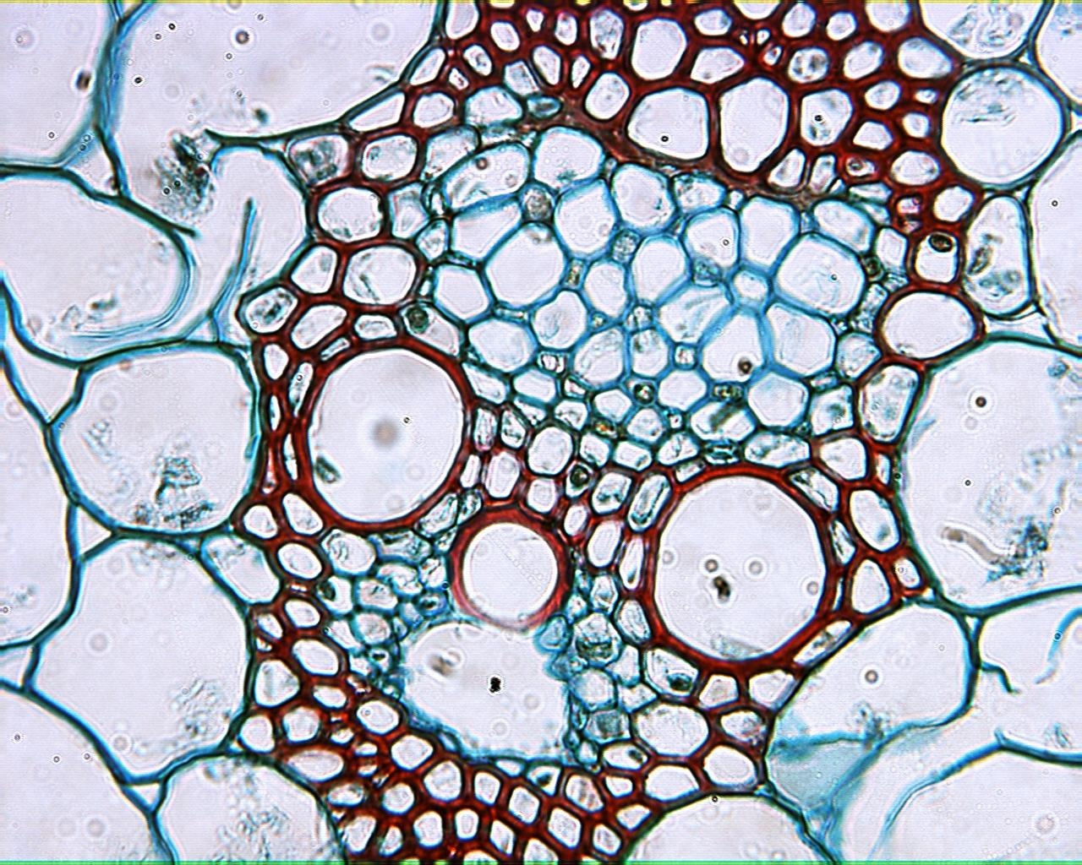
Zea Stem 400X

Slide 31
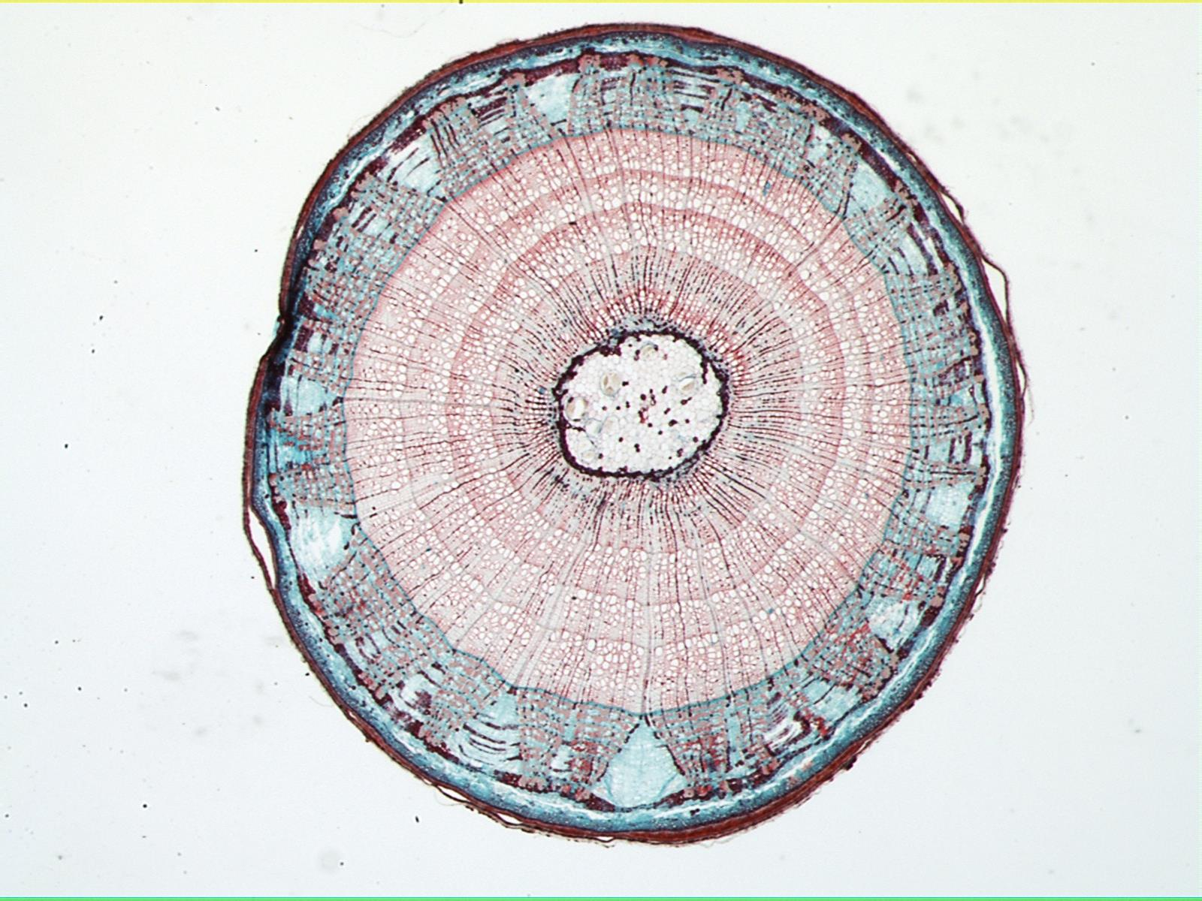
Tilia stem 30X

Slide 32
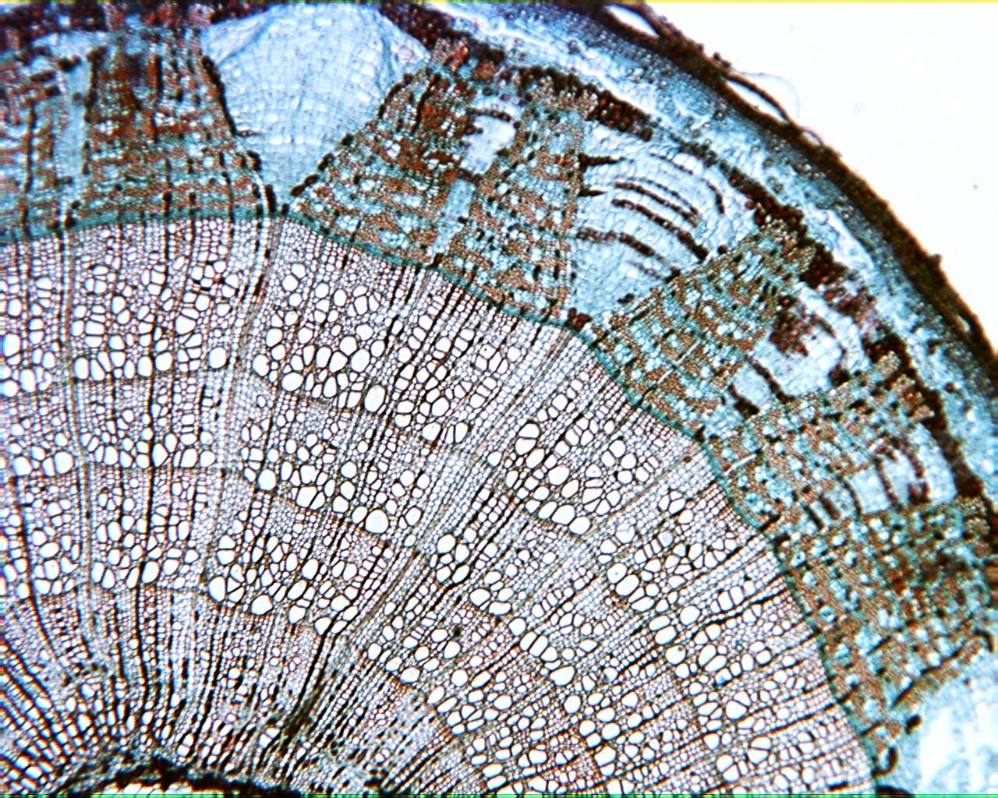
Tilia stem 40X

Slide 33
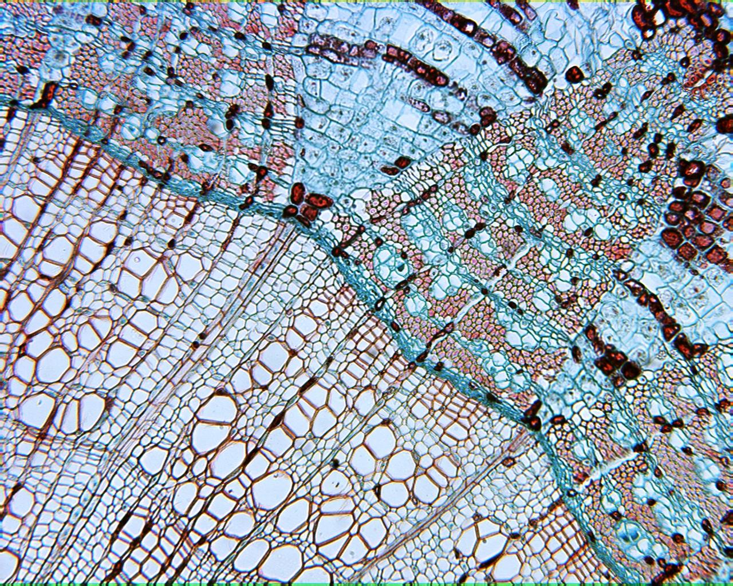
Tilia stem 100X

